Slide 1
B.Tech. Project
Mid-Term Evaluation
Advisor -
Dr. Siladitya Pal
Aman Shrivastava - 13117008
Mihir Ujjwal Rana - 13117044
Yash Sharma - 13117079

Slide 2
Introduction
Composites -
Composites are made by combining two or more natural or artificial materials to maximize their useful properties and minimize their weaknesses. One of the oldest and best-known composites, glass-fiber reinforced plastic (GRP), combines glass fibers (which are strong but brittle) with plastic (which is flexible) to make a composite material that is tough but not brittle. Composites are typically used in place of metals because they are equally strong but much lighter.

Slide 3

Applications
Airbus A380
More than 20 % of the A380 is made of composite materials, mainly plastic reinforced with carbon fibres. The design is the first large-scale use of glass-fibre-reinforced aluminium, a new composite that is 25 % stronger than conventional airframe aluminium but 20 % lighter.

Slide 4
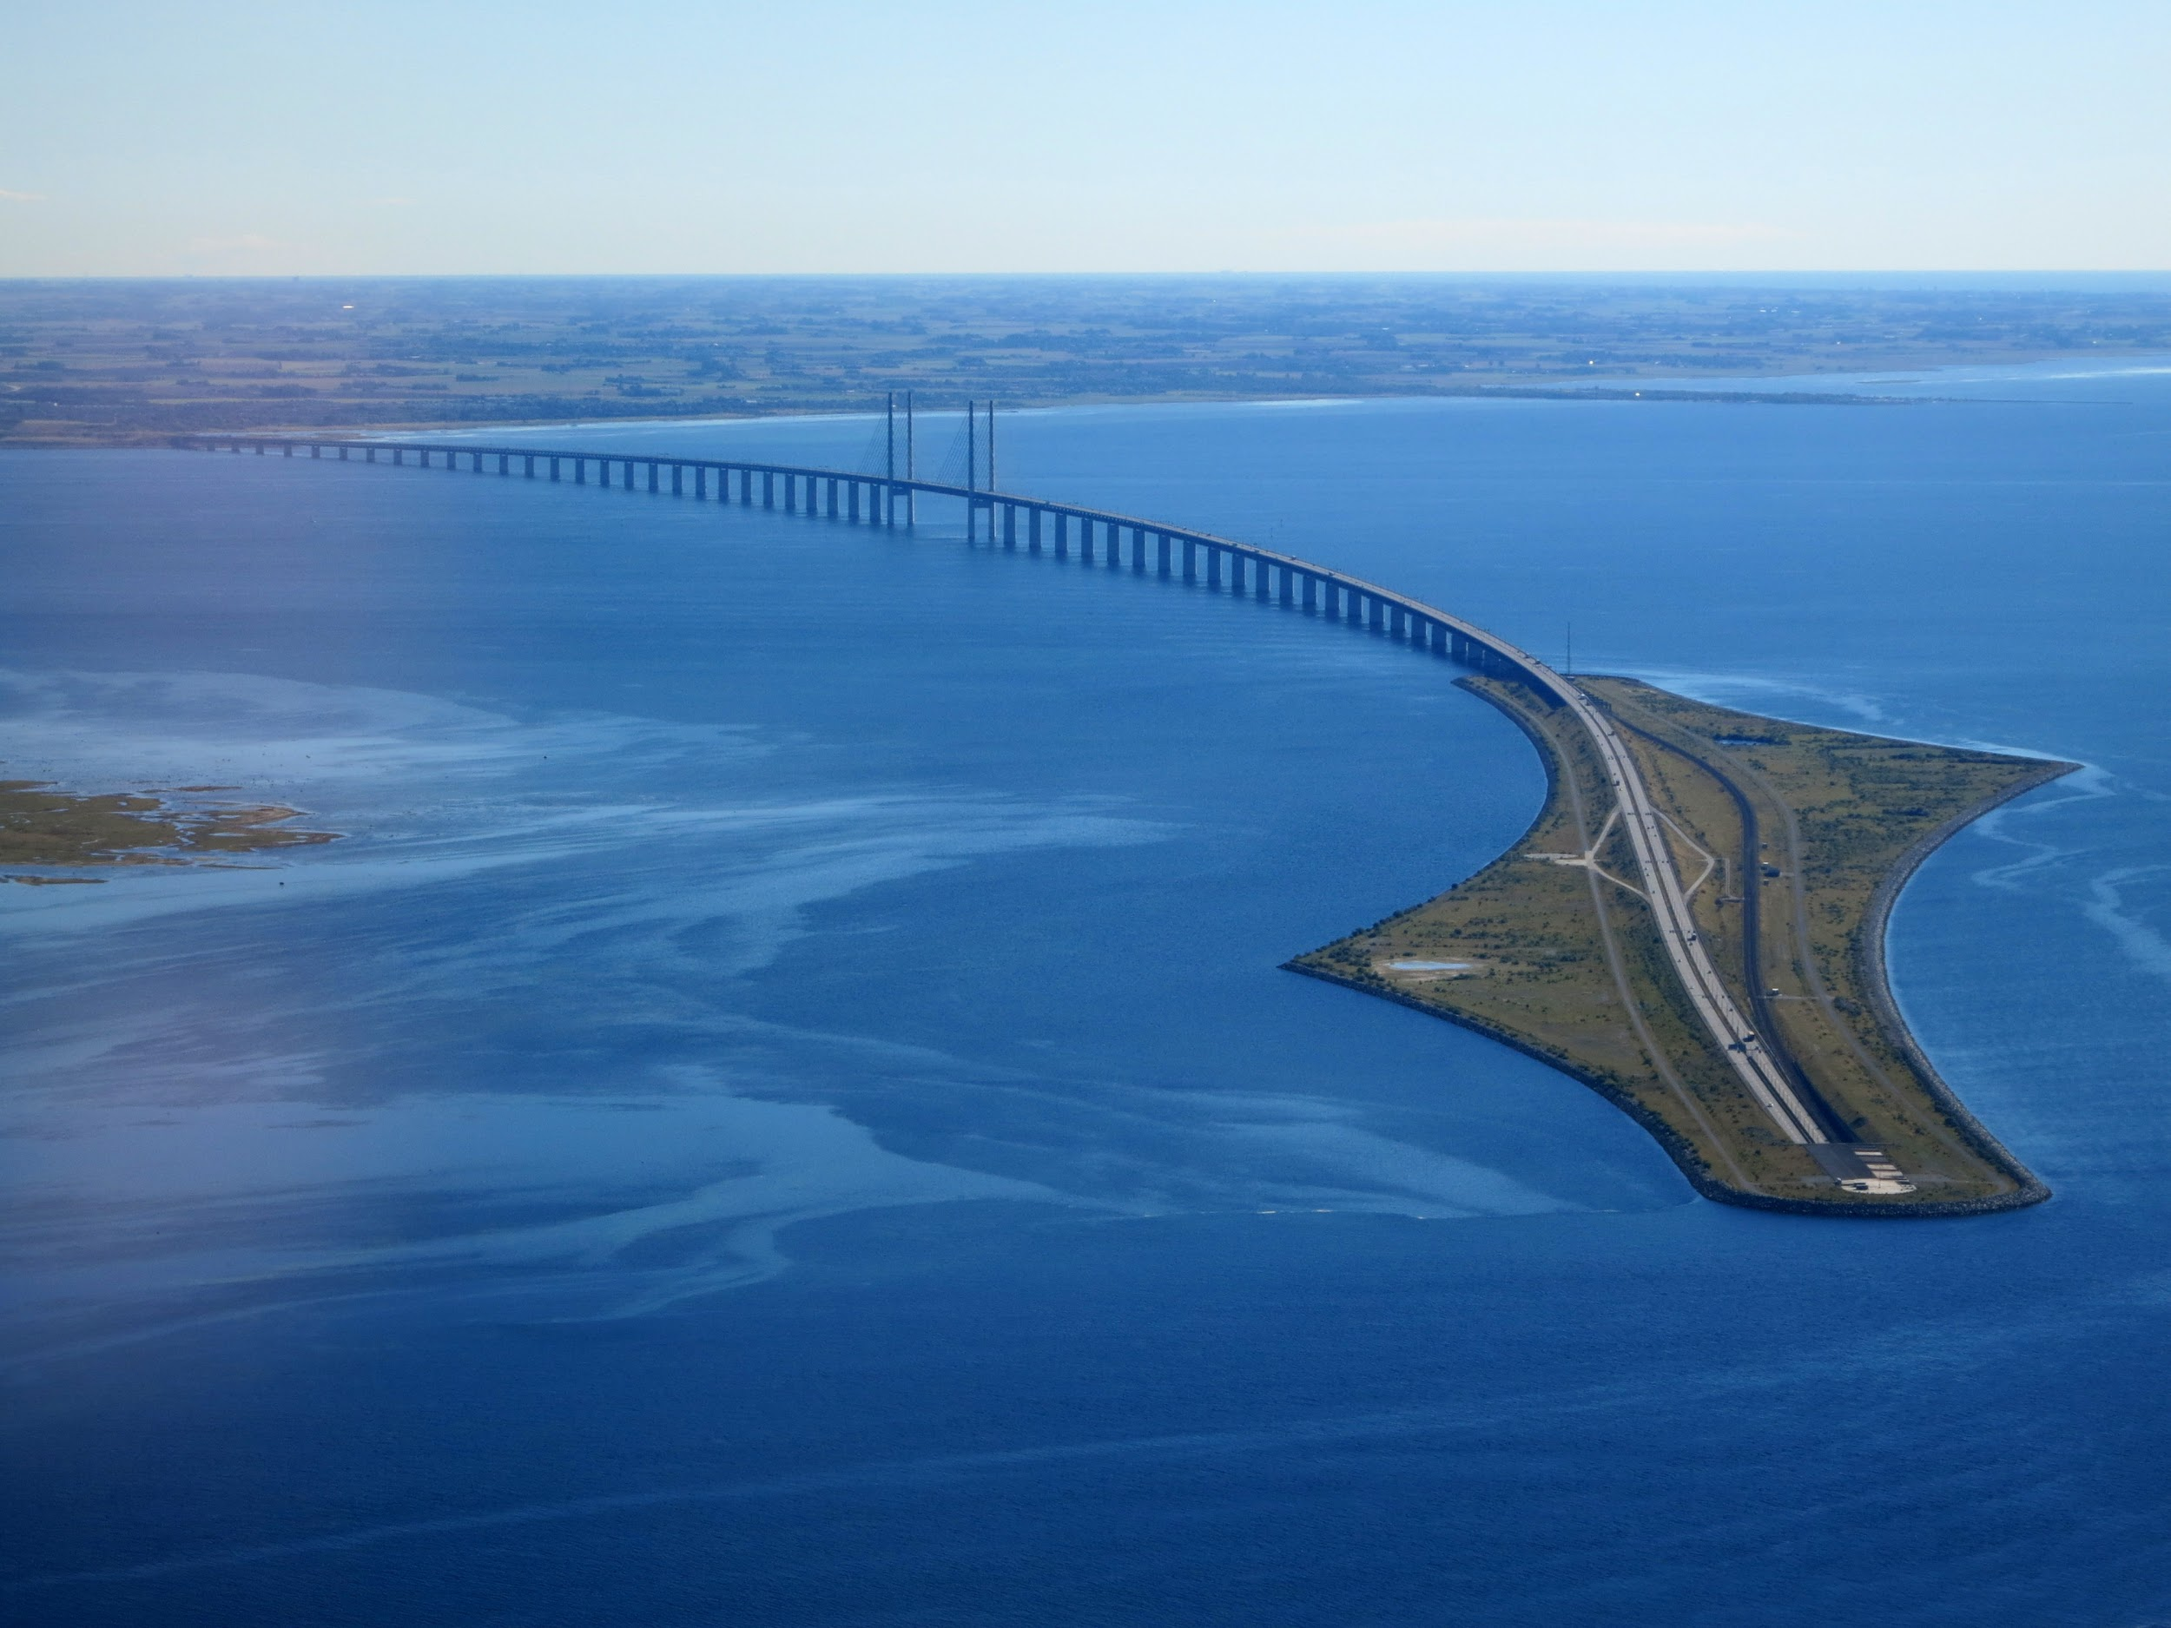
Applications
Concrete
Concrete is a versatile and cheap material, with a vast range of applications around the home. Brick laying, constructing paths and driveways, foundations to buildings and walls, are some of the practical applications. Concrete has a similarly wide and varied range in industrial applications.

Slide 5
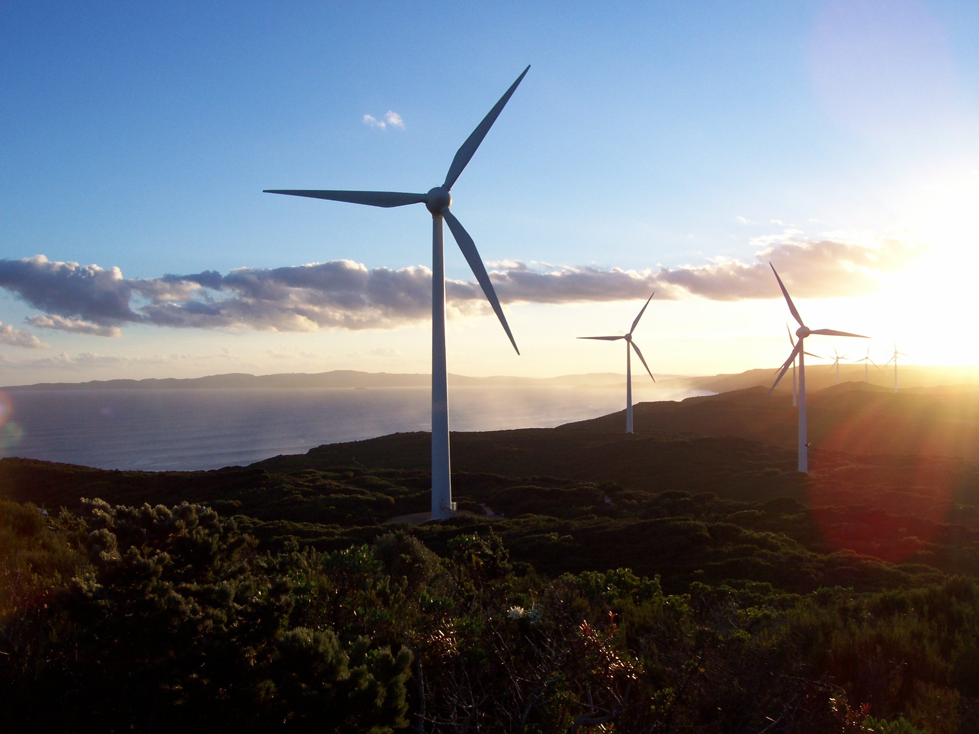
Applications
Wind Turbine
Currently, carbon fiber is used primarily in the spar, or structural element, of wind blades longer than 45m/148 ft, both for land-based and offshore systems. The higher stiffness and lower density of CF allows a thinner blade profile while producing stiffer, lighter blades.

Slide 6
Challenges
Since precise material properties are often needed to satisfy industrial needs and criteria, design of composites with tailored properties is of utmost importance.
The design and analysis of such composites faces following challenges -
Computational Expense
Heavy Simulations
Rigorous Experimentation
Time Expensive Process

Slide 7
Project objective:
To develop an algorithmic framework to predict properties of composites to aid in modelling process.

Slide 8
Methodology
Assumptions:
The analysis is confined to 2-D.
All particles (epoxy) are perfectly circular in shape.
The analysis is confined to two phases of the composite.
Very small particles will be ignored assuming they have negligible overall effect.

Slide 9
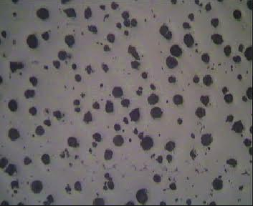
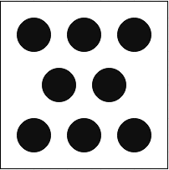
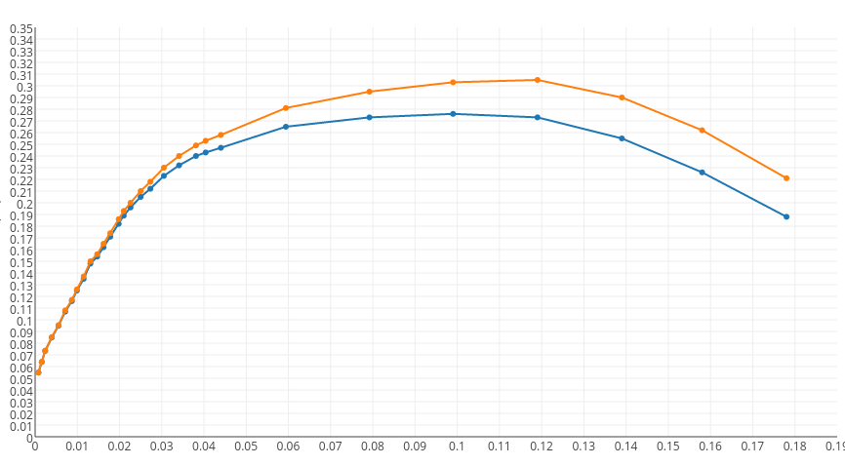
ML Predictive Model
Simulations

Slide 10
Extracting a Structure Variable

Slide 11
(i) (ii) (iii)
Difference?

Slide 12
Ending Notes
We aim to build a robust database that not only predicts the aggregate properties like tensile strength of a composite, but also gives us possible combinations of composites and arrangements of particles for a desired strength, toughness, etc. of the material.
We also aim to distinguish between composites of same volume fraction but different arrangement of particles using some form of quantification by processing the image of material (2D).

Slide 13
Thank You!
Any Questions?

